Slide 1

HEALTHCARE DATA ANALYSIS

Slide 2
PROJECT MENTOR
MR. SHUBHAM KABRE
GROUP - 6
TEAM MEMBERS
Mr Shubham Kumar Rai
Ms Shruti B. Jadav
Mr Chinmay

Slide 3
What makes Dialysis Center Successful ?
Proper Management and Staff Qualification
Maintain Positive Culture around patients
Offer Comprehensive Patient Care
Patient experience survey

Slide 4
Project KPI’s
KPI 1
KPI 2
Number of Patient across various Summaries
Profit V/S Non Profit
KPI 3
KPI 4
Chain Organization w.r.t.
Total Performance Score as
No Score
Dialysis Station STATS
KPI 5
KPI 6
# Category Text – As Expected.
Average Payment Reduction Rate

Slide 5
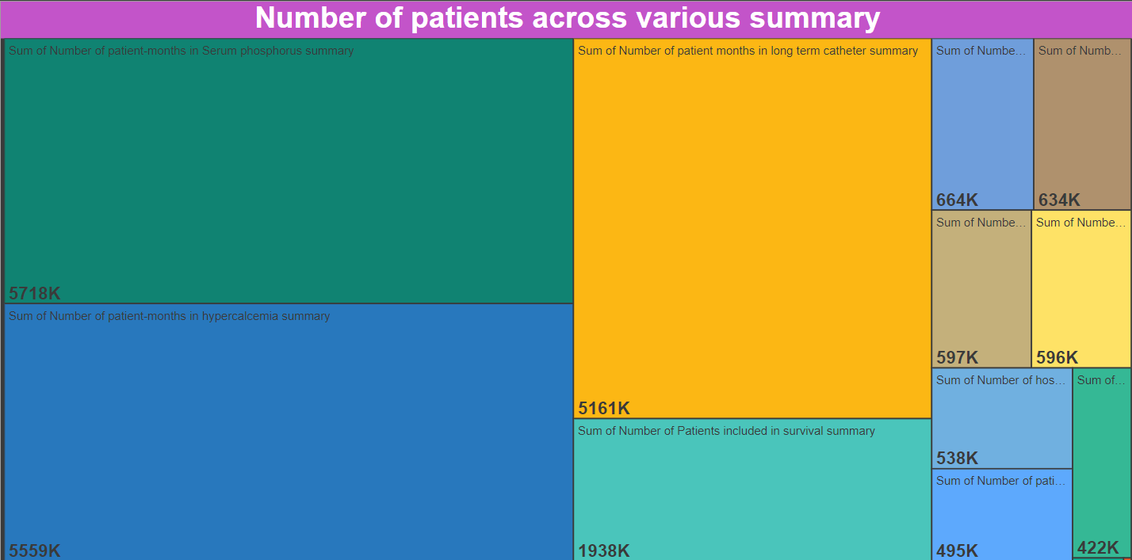
KPI 1 - Number of Patients across various Summaries
Patient Summary is a standardized collection of patient information, the necessary minimum and sufficient data to inform a patient’s treatment at a point of care.

Slide 6
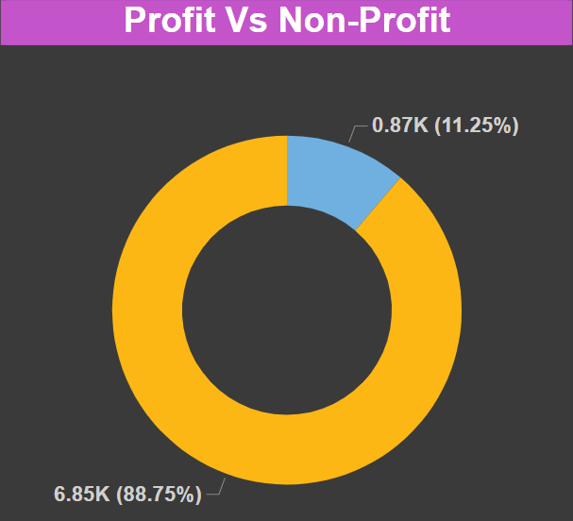
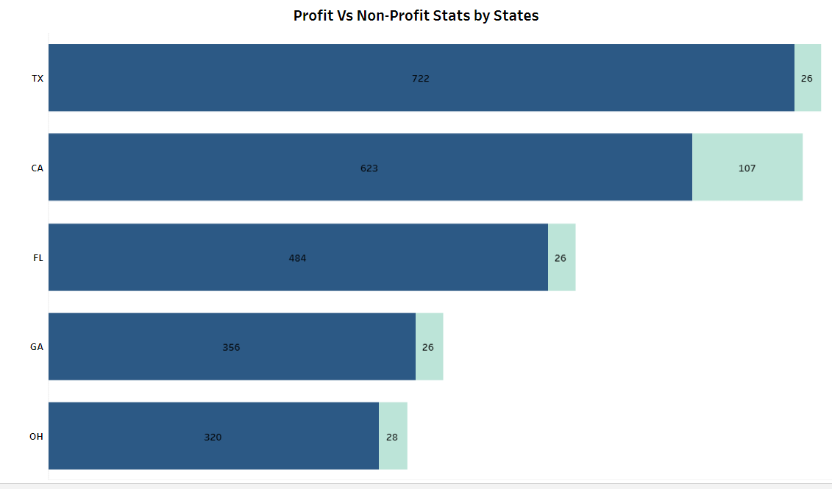
KPI 2 - Profit V/S Non Profit
Profit Organization | Non-Profit Organization
These are privately owned hospitals or healthcare systems operated with the objective of generating profit. | It’s a organization that operates for public benefit & focusing on health-related issued without a primary goal of making a profit
Total Profit Organization is 6854. | Total Non-Profit Organization is 869.
TX state has most Profit Organization. | CA state has most Non-Profit Organization.

Slide 7
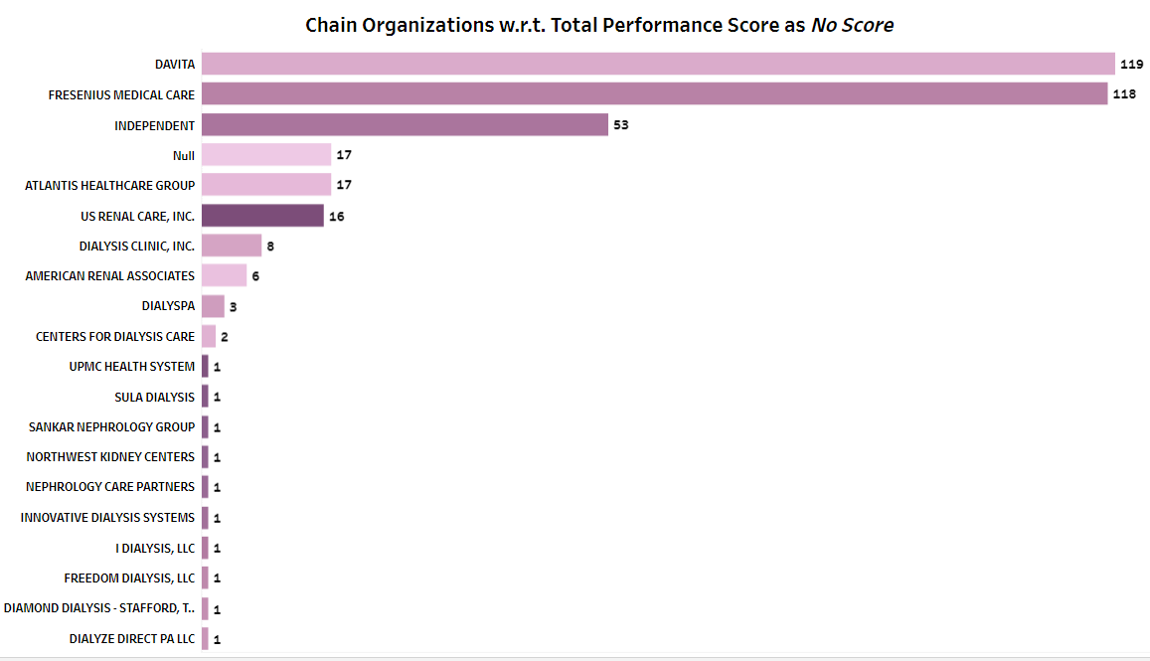
KPI 3 – Chain Organizations Total Performance as No Score
Chain Organization - A type of business with multiple retail locations (Dialysis Stations) that one company owns and operates.
The principal advantages of chain organization include the ability of the central purchasing unit to buy on favorable terms, lower operating costs.
Totally there are 117 Chain Organizations.
﻿﻿Total Number of Dialysis Stations was highest for DAVITA - 50102, followed by FRESENIUS MEDICAL CARE - 49135and INDEPENDENT – 11739.
DAVITA accounted for 37.10% of Total Number of Dialysis Stations.

Slide 8
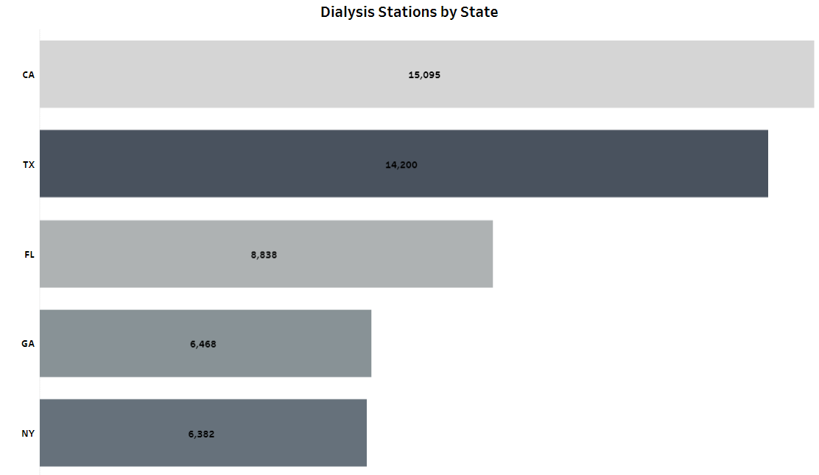
KPI 4 – Dialysis Station STATS
Total Number of Dialysis Stations – 135.055K
Total Number of In-Center Hemodialysis Stations – 7261
Total Number of Peritoneal Dialysis – 4041
Total Number of Home Hemodialysis Training - 2238

Slide 9
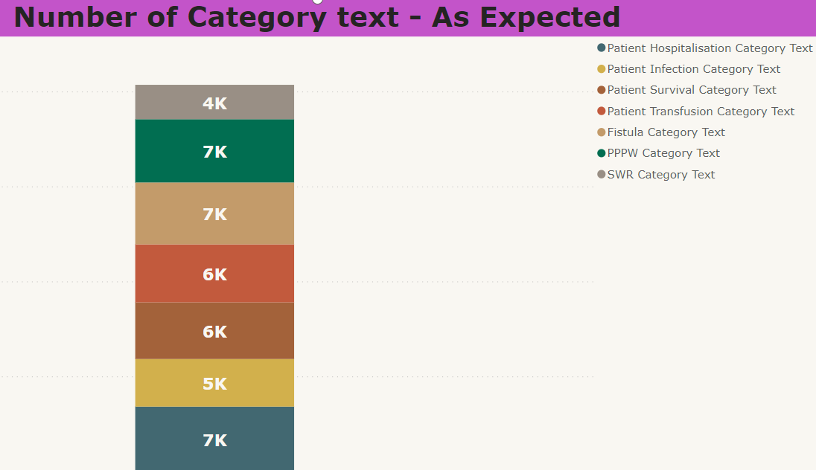
KPI 5 – Number of Category Text – As Expected
Patient Category is the status of patient at the time Admission or Treatment , it indicates patient's risk profile - how often the patient needs treatment
Treatment Type | Category Text
Treated more often | Worse Than Expected
Treated less often | Better Than Expected
About the Same | As Expected

Slide 10
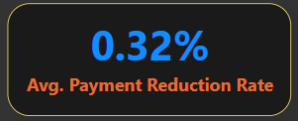
KPI 6 – Average Payment Reduction Rate
When a facility doesn't meet established performance standards, CMS lowers that facility's payments by up to 2% for an entire payment year (PY). This gives the facilities a financial incentive to improve patient care and meet national standards established by CMS.
The system shall calculate Payment Reduction Percentages for a facility based on how a facility’s TPS compares to the minimum TPS specified for the Payment Year.
Average of PY2020 Payment Reduction Percentage was highest for ISD Renal Inc at 0.5%, followed by Total Renal Care, Inc. and Total Renal Care Inc.
Across all 2,871 Facility Name, Average of PY2020 Payment Reduction Percentage ranged from 0.01 to 0.2

Slide 11
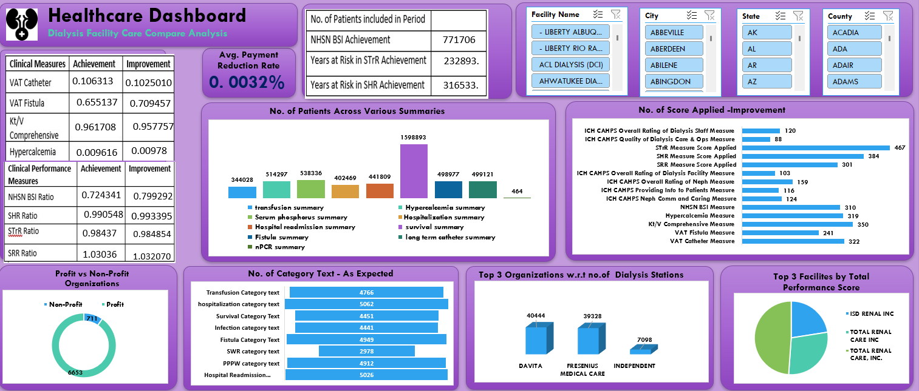
EXCEL DASHBOARD

Slide 12
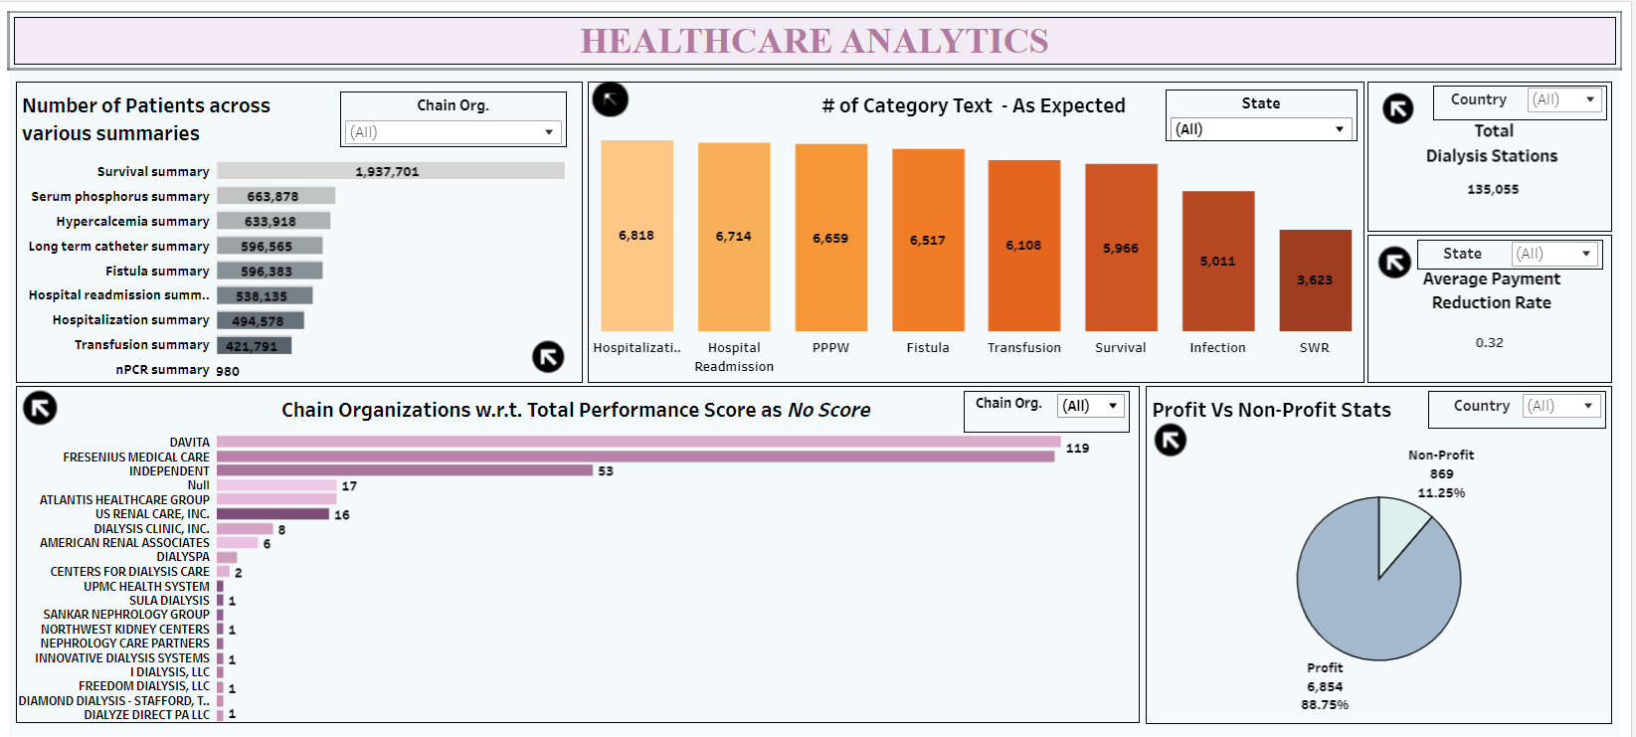
TABLEAU DASHBOARD

Slide 13
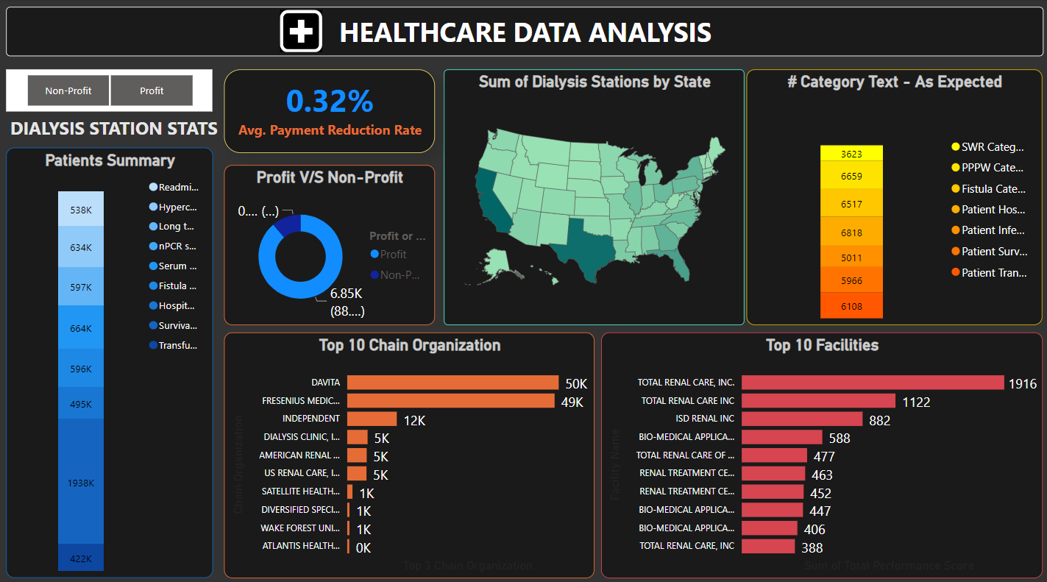
POWERBI DASHBOARD

Slide 14
Key Findings
The Total Renal Care Inc. facility center located in Lakville, MN has achieved a TPS score of 100 points, indicating that the facility provided is of high quality.
According to TPS Score, ISD Renal, Inc Facility center has "No reduction" for the Payment year 2020. The states of IN, MS, OH, and TN have provided better care for dialysis patients
According to TPS,PY of cities like New York, Florence, Shiloh, Bowling Green have been reduced by 2% & doesn't meet the needs of performance standard provided by CMS for Total Renal Care Inc Facility center
Facility centers like East Atlanta Dialysis, East Tennesse Dialysis care, Nocturnal Dialysis Spa, have No TPS score and should be worked on performance & management system to provide better facility & care to patients
States (Mortality Rate) - PR (35.81), AR (25.80),MP (25.80) , AS (25.50), ID (24.89) are having high mortality rate , its good to go through the number of patients summaries before expanding their services in these regions
Some facilities may not have enough data to calculated a specific measure score or TPS. This doesn't reflect the quality of care provided in those facilities

Slide 15
THANK YOU

